Slide 1

EE 272 Digital Systems Fall 2019
Instructor: Dr. Aashir Waleed
Lecture 7a – 1
Chapter 6 Counters

Slide 2
Lecture Overview
ELEC2200 Fall 2014 – L.Yobas
Lecture 7b – 2
Common Sequential blocks and their implementation
Counters
Ripple counters
Synchronous binary counters
Other counters: Ring counter, Johnson counter
Reading Assignments:
Chapter 6 of Textbook

Slide 3
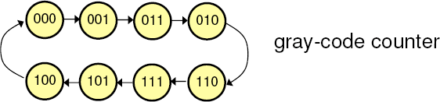
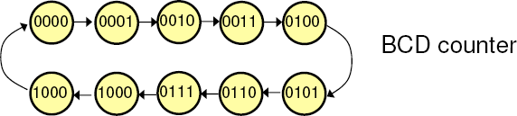
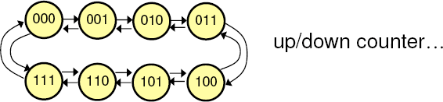
Other Count Sequences Examples
ELEC2200 Fall 2014 – L.Yobas
Lecture 7b – 4

Slide 4
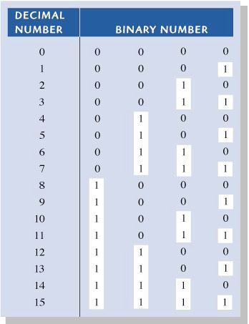
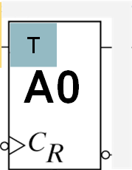
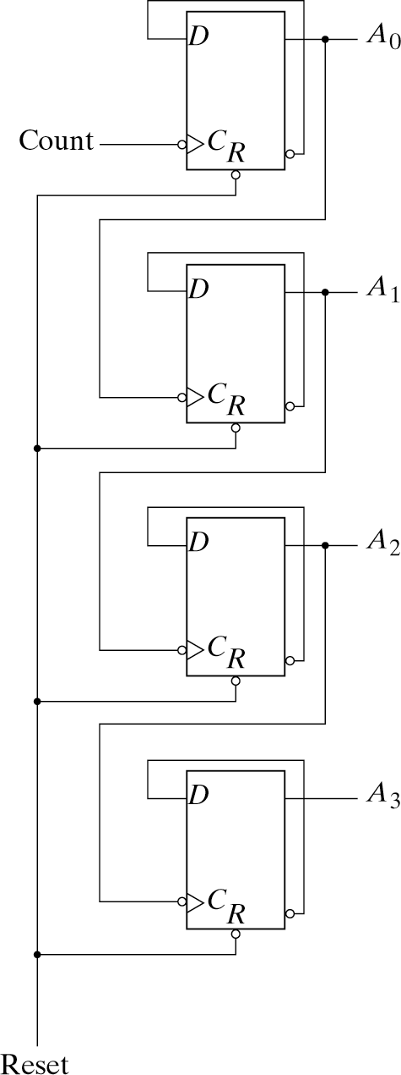

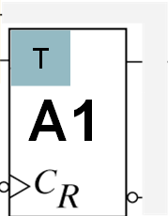
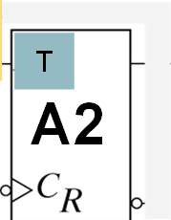
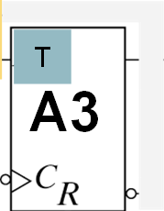
4-bit ripple UP counter (T-FF)
ELEC2200 Fall 2014 – L.Yobas
Lecture 7b – 11
A3
A2
A1
A0
1
T
A0
CLK
Toggles when CLK 1 → 0
1
Toggles when A₀ 1 → 0
1
Toggles when A₁ 1 → 0
1
Toggles when A₂ 1 → 0
T
A1
T
A2
T
A3

Slide 5
4-bit ripple UP counter (D-FF)
ELEC2200 Fall 2014 – L.Yobas
Lecture 7b – 12
A3
A2
A1
A0
CLK
A0
Toggles when CLK 1 → 0
A1
Toggles when A₀ 1 → 0
A2
Toggles when A₁ 1 → 0
A3
Toggles when A₂ 1 → 0

Slide 6

4-bit ripple DOWN counter (D-FF)
ELEC2200 Fall 2014 – L.Yobas
Lecture 7b – 13
A3
A2
A1
A0
CLK
A0
Toggles when CLK 1 → 0
A1
Toggles when A₀ 0 → 1
A2
Toggles when A₁ 0 → 1
A3
Toggles when A₂ 0 → 1

Slide 7
4-bit ripple DOWN counter (D-FF)
ELEC2200 Fall 2014 – L.Yobas
Lecture 7b – 14
A3
A2
A1
A0
CLK
A0
Toggles when CLK 0 → 1
A1
Toggles when A₀ 0 → 1
A2
Toggles when A₁ 0 → 1
A3
Toggles when A₂ 0 → 1

Slide 8












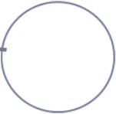



4-bit ripple counter
Lecture 7b – 16
0000 0001
0010
0011
0100 0101
0110
0111
Binary Counting sequence
1111 1110
1101 1011 1010 1001
1100 1000
We can also build a ripple counter using D-flip flop
Timing Waveform
count
A0 A1
A2 A3
Question: How to build a binary countdown counter?

Slide 9
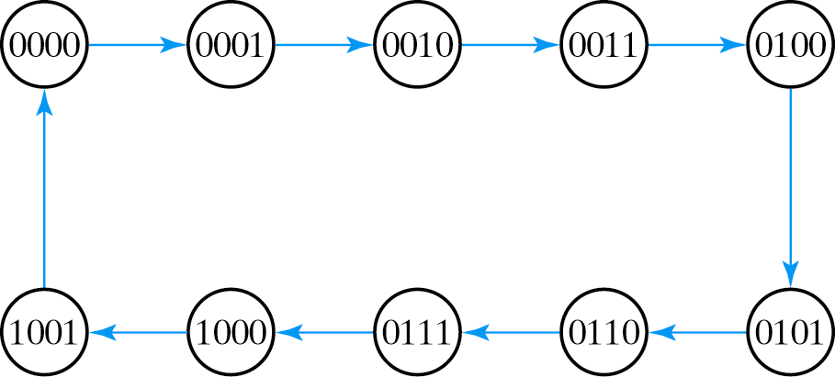
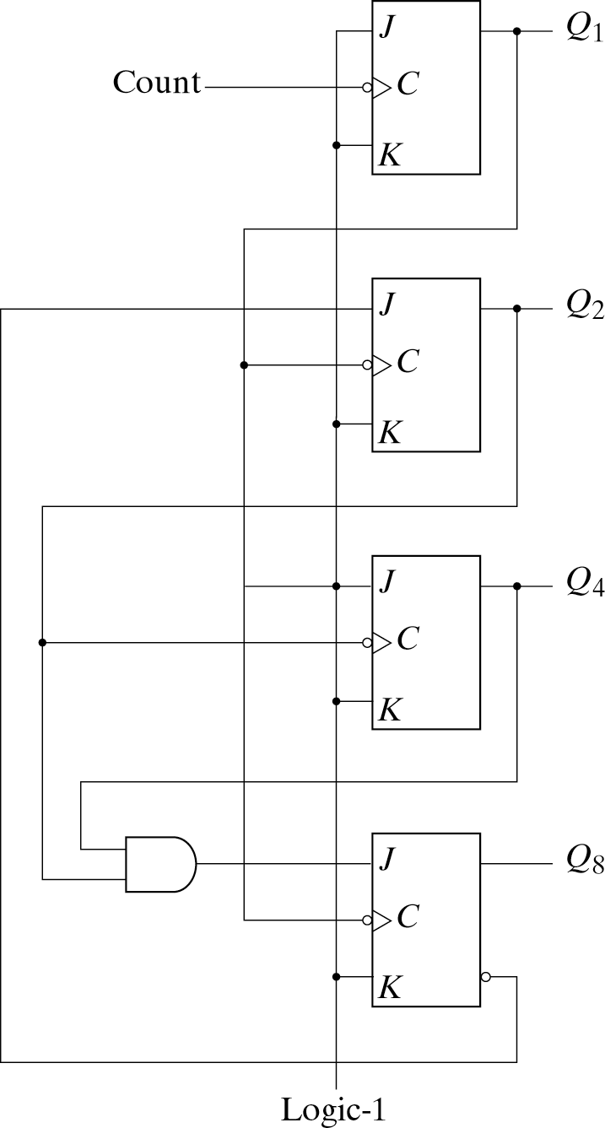

Asynchronous BCD Ripple Counter
Lecture 7b – 17
Counting sequence
BCD counter requires 4 J-K flip-flops for 10 finite states
This BCD “ripple” counter is actually composed of 2 counters
one is a 1-bit “÷2” counter for Q1
the other is a “÷5” counter for Q2, Q3 and Q4
Strictly speaking, the second counter is not a ripple counter?
Flip-flop is not in toggle mode
But the connection is “ripple”

Slide 10
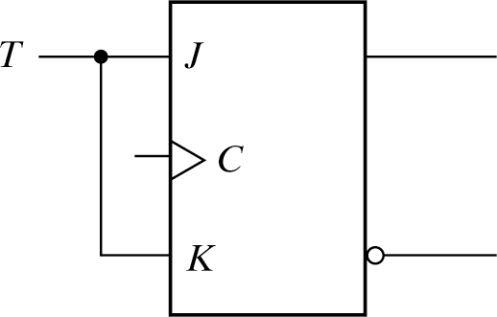
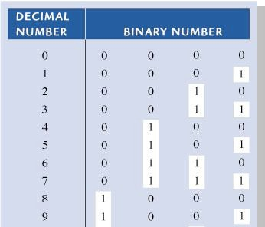


Asynchronous BCD Ripple UP Counter
Lecture 7b – 18
A0 & A2 same as Binary Counter A1 & A3 require modification!
A1 toggles when A0: 1→0 AND A3 = 0
A3 toggles when A0: 1→0 AND A2&A1 = 1 A3 resets when A0: 1→0 AND A2&A1 = 0
A0
A3 | A2 | A1 | A0
A1
A2
A3

Slide 11
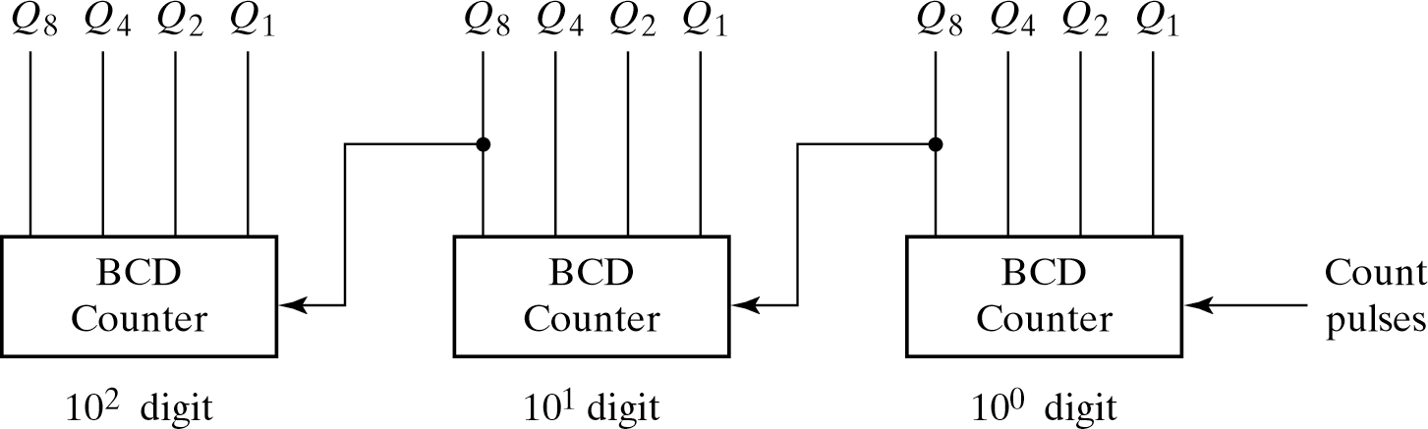
Multi-decade decimal BCD counter
Lecture 7b – 19
BCD ripple counters are commonly used
– Each BCD ripple counter represent one decimal digit
We can cascade BCD ripple counters for more decimal digits counting by a “ripple” manner
» Output of previous stage goes to clock of the next stage

Slide 12
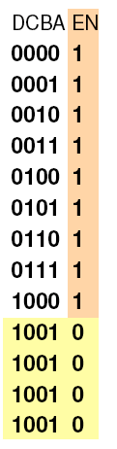
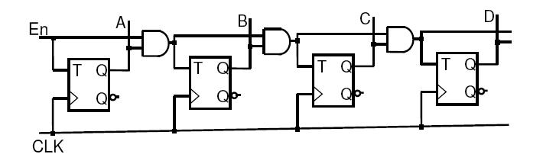
Synchronous counter
Lecture 7b – 20
The counters that we discussed above are asynchronous counter
The clock input of some flip-flop are coming from the output of the other flip-flop, not coming from a global clock signal
Synchronous counter
Same clock pulses are applied to the inputs of all fliplfops.
Example: 4-bit synchronous binary counter
Toggle bit if all previous are ‘1’
T_{A} = EN; T_{B} = EN.A T_{C} = EN.A.B T_{D} = EN.A.B.C

Slide 13
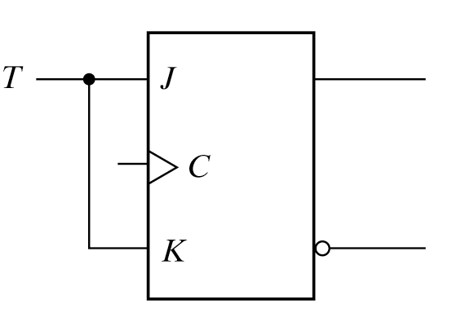
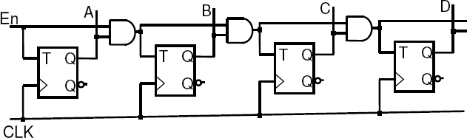
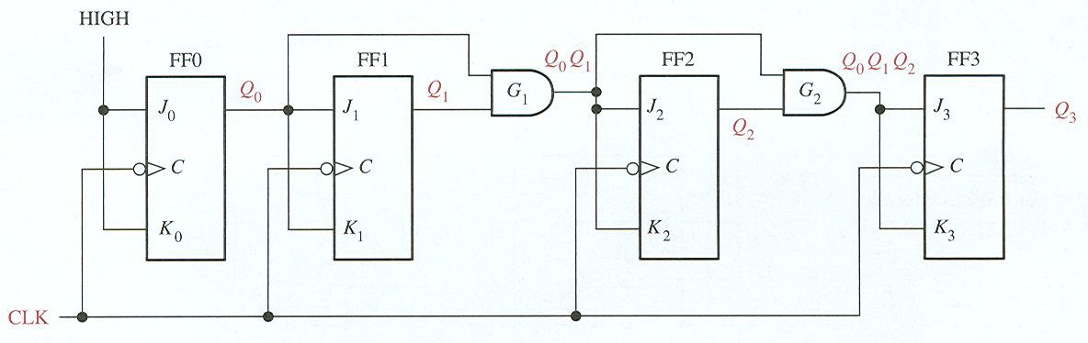
Synchronous UP counter
Lecture 7b – 21

Slide 14
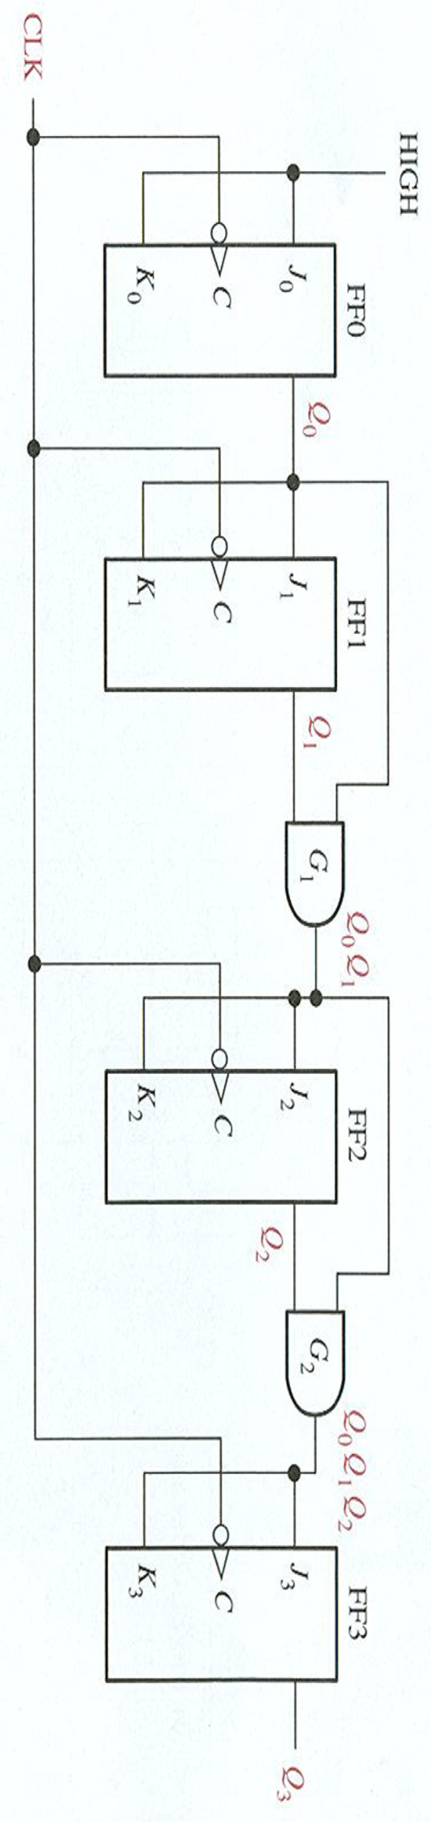

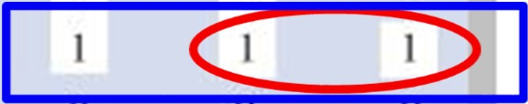
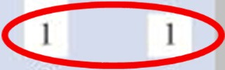

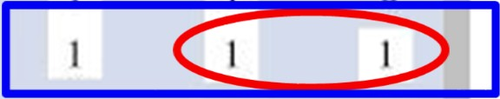

Synchronous UP counter
Lecture 7b – 22
A3 | A2 | A1 | A0
A0
Toggle bit if all previous are ‘1’
A1
A2
A3

Slide 15
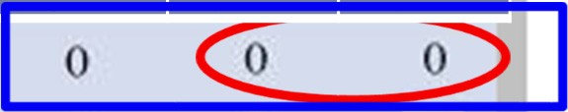




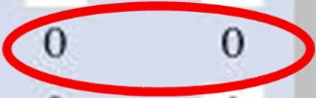
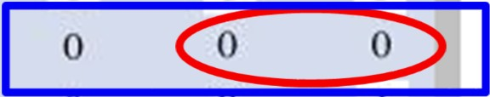



Synchronous DOWN counter
Lecture 7b – 23
A3 A2 A1 A0
A0
Toggle bit if all previous are ‘0’
A1
A2
A3

Slide 16
Synchronous Counter
Lecture 7b – 24
Similar to a Finite State Machine (we will talk about this in next topic)
State is the output and equal the count value of the counter
The current state is the current count and next state is the next count
Based on the current count and the next state combinational logic, at the clock edge, we can generate the next state.
Counter has no data inputs, only has clock input
We will analysis the counter behavior and come up with design procedure to design general counter when we discuss Finite State Machine in the later lecture
In the following we will present some simple synchronous counter example
Clocks
Next-state Combinational Circuit
Finite
States
Outputs = states = current count
Feedbacks

Slide 17

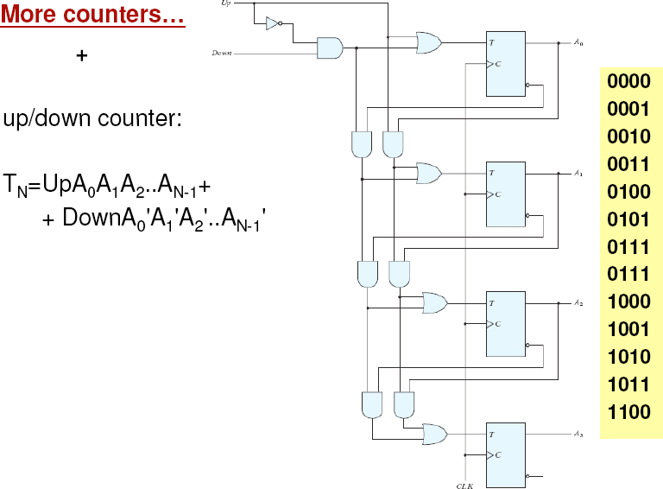
Synchronous Up-down counter
Lecture 7b – 25

Slide 18

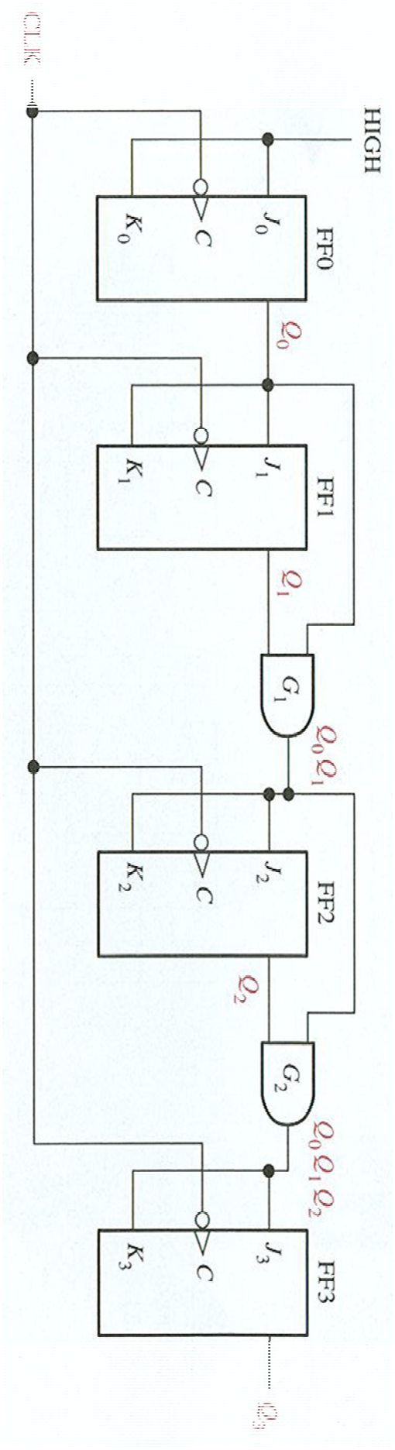
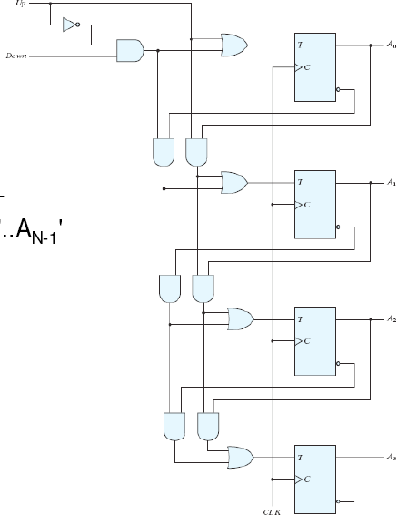

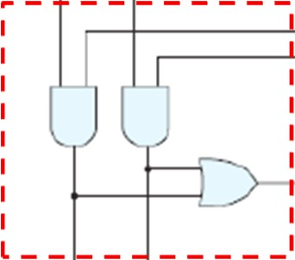




Synchronous Up-down counter
Lecture 7b – 26
UP DOWN
A0
A 0
?
A1
A 1
A2
A 2
A3
A 3

Slide 19
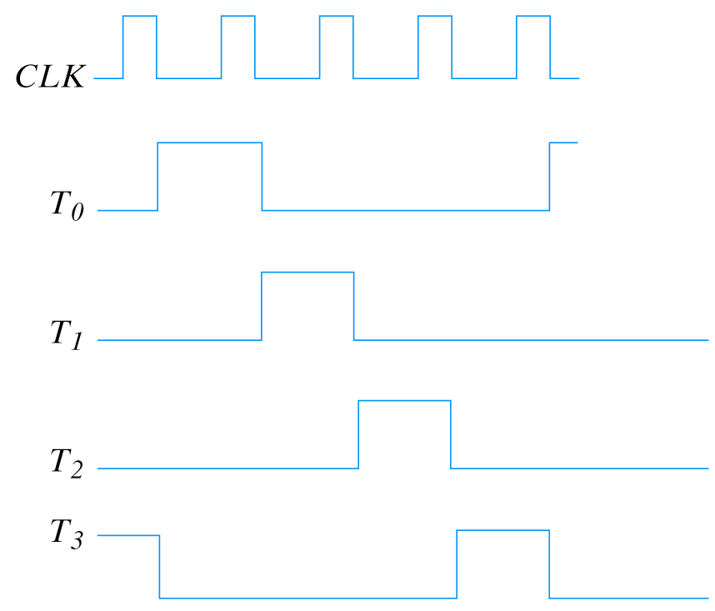
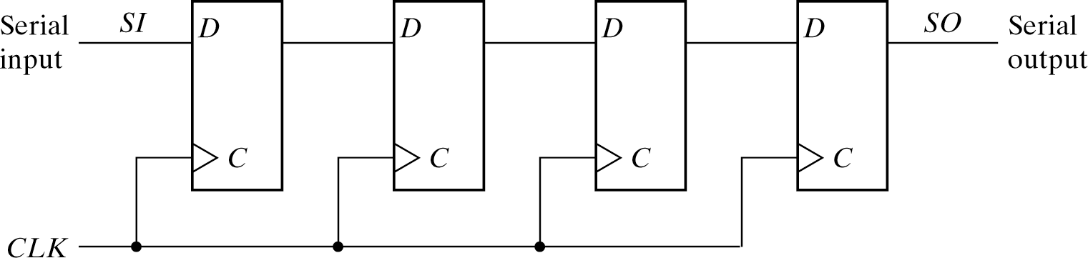
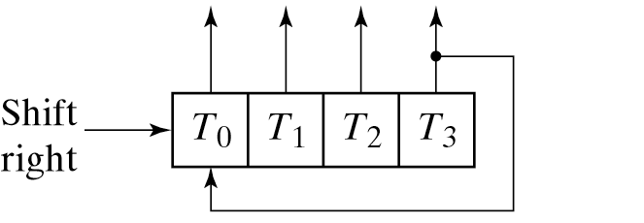




Other counter – ring counter (non-binary counter)– made by D-flip-flop
Lecture 7b – 27
D or JK flip-flops in set/reset modes can be used for shift registers and hence ring counter
N flip flops are use for counting N
N-bit ring circulates a single bit among the N flip-flops to provide N distinguishable states
State transition for 4-bit ring counter
0001
0010
1000
0100
Counter has unused state, use N states out of 2^{N} states.

Slide 20
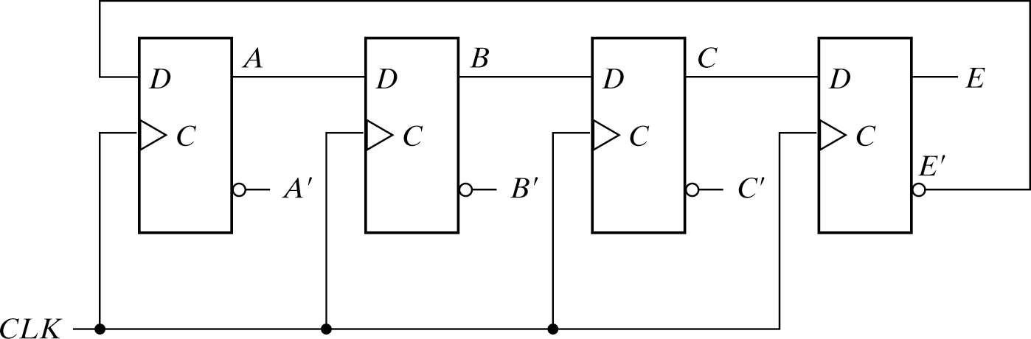
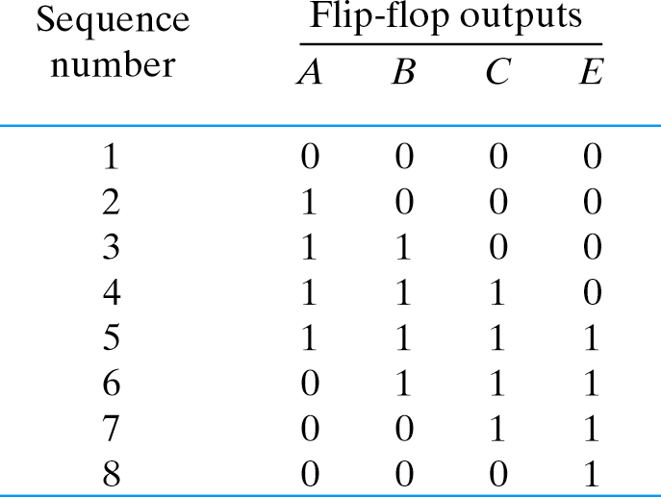
Johnson counter
Lecture 7b – 28
Similar to ring counter, Johnson counter is a synchronous n-bit switch-tail ring counter. It has more states than ring counter
It uses 2n decoding gates to provide outputs for 2n timing signals
AND gate required for output
A’E’ 0
AB’ 0
Example If
ABCE=1100
BC’ | 1
CE’ | 0
AE | 0
A’B | 0
B’C | 0
C’E | 0
8 AND gates to generate the sequence of 8bits

